Slide 1
1.1
Blah

Slide 2
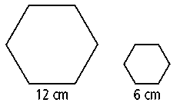
Areas of Similar Shapes Revisited:
Ratio of Sides | Ratio of Perimeters | Ratio of Areas
6) The hexagons at the right are similar. What is the ratio (smaller to larger) of their perimeters and their areas?
Ratio of Sides | Ratio of Perimeters | Ratio of Areas

Slide 3
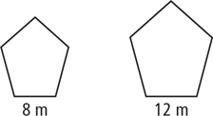
Finding the missing perimeter:
The figures in each pair are similar. The perimeter of one figure is given.
7)
Write a proportion:
Ratio of perimeters (using sides)
Ratio of ACTUAL perimeters
Perimeter of smaller pentagon = 40 m
=

Slide 4
Going further…
Ratio of Sides | Ratio of Perimeters | Ratio of Areas
3) The ratio of the areas of two rectangles is 49:36.
a) What is the ratio of the sides?
b) What is the ratio of the perimeters?
4) The ratio of the areas of two rectangles is 32:50.
a) What is the ratio of the sides?
b) What is the ratio of the perimeters?

Slide 5
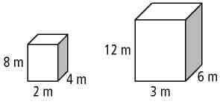
Connections: Scale Factor, Surface Area and Volume
What is the scale factor of the sides? Simplify if needed.
The two rectangular prisms are similar.
What is the ratio of the surface areas of both prisms?
What relationship do they have with the scale factor?

